Slide 1
UNIT-3
Lecture 2

Slide 2
Univariate Analysis:
Univariate analysis means analyzing one variable at a time.
Used to:
Understand distribution
Detect outliers
Check frequency
Find patterns
Examples:
Age distribution
Salary distribution
Gender count

Slide 3
Types of Plots in Univariate Analysis:
For numerical data
Histogram
Box plot
For categorical data
Count plot

Slide 4
What is Histogram?
A histogram shows the distribution of numerical data.
It divides data into bins and shows frequency.
Used for:
Age
Marks
Salary

Slide 5
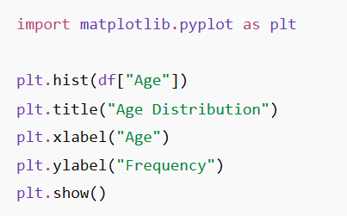

Histogram Using Matplotlib:
If histogram is:
Symmetric → normal distribution
Right skewed → high values present
Left skewed → low values present

Slide 6
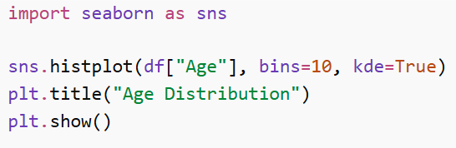
Histogram Using Seaborn:
Advantages:
Better visualization
Kernel Density Estimation (KDE)

Slide 7
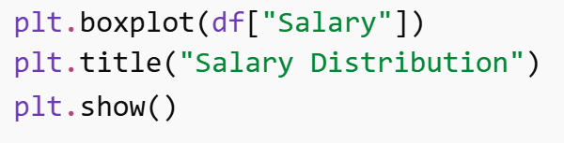
Box Plot (Outlier Detection):
Box plot visualizes:
Median
Quartiles
Outliers

Slide 8
Advantages of Univariate Analysis:
Simple and easy to interpret
Helps understand variable distribution
Detects outliers
Useful for data cleaning
Prepares data for further analysis

Slide 9
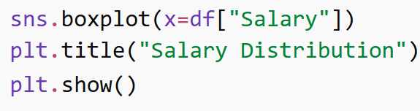
Box Plot Using Seaborn:
Box plot components:
Minimum
Q1 (25%)
Median
Q3 (75%)
Maximum
Outliers

Slide 10
Example 1:
Given the dataset: 2, 4, 5, 6, 8, 9, 10, 12, 30

Slide 11

Step 1: Arrange Data
2, 4, 5, 6, 8, 9, 10, 12, 30
Step 2: Median (Q2)
Number of values = 9
Median position = $\left(9+1\right)/2=5$
Median = 8

Slide 12

Step 3: First Quartile (Q1)
Lower half: 2, 4, 5, 6
$Q1=\left(4+5\right)/2=4.5$
Step 4: Third Quartile (Q3)
Upper half: 9, 10, 12, 30
$Q3=\left(10+12\right)/2=11$

Slide 13
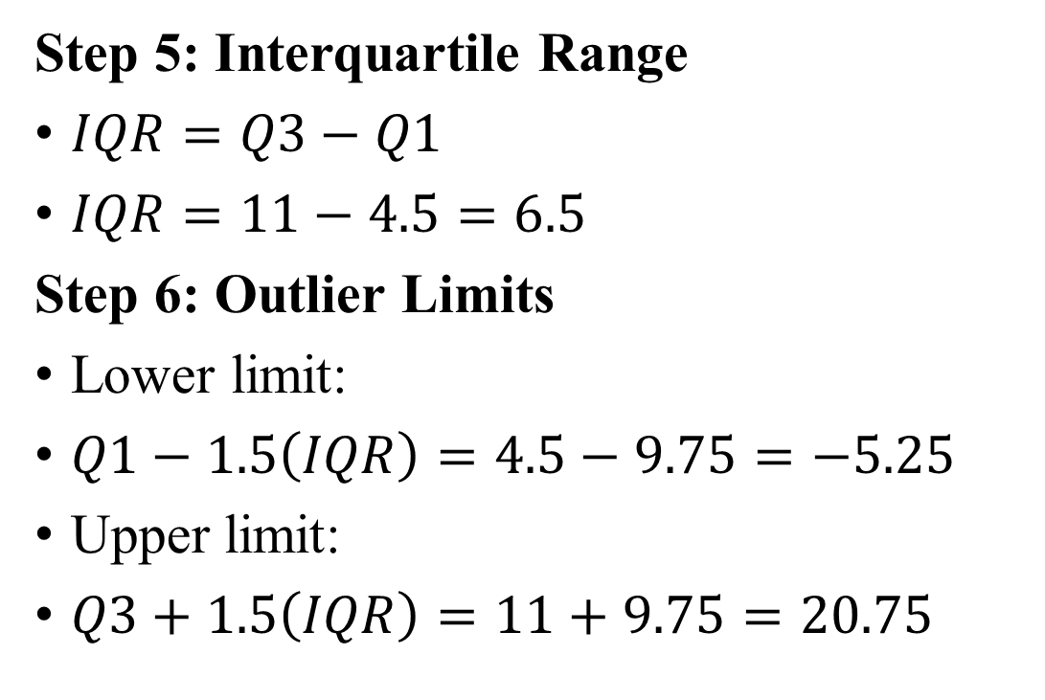
Step 5: Interquartile Range
$IQR=Q3−Q1$
$IQR=11−4.5=6.5$
Step 6: Outlier Limits
Lower limit:
$Q1−1.5\left(IQR\right)=4.5−9.75=−5.25$
Upper limit:
$Q3+1.5\left(IQR\right)=11+9.75=20.75$
Values greater than 20.75 are outliers.
Dataset value 30 > 20.75
30 is an outlier

Slide 14
Example 2:
Consider the following data: 5, 7, 8, 12, 13, 14, 18, 21, 23

Slide 15
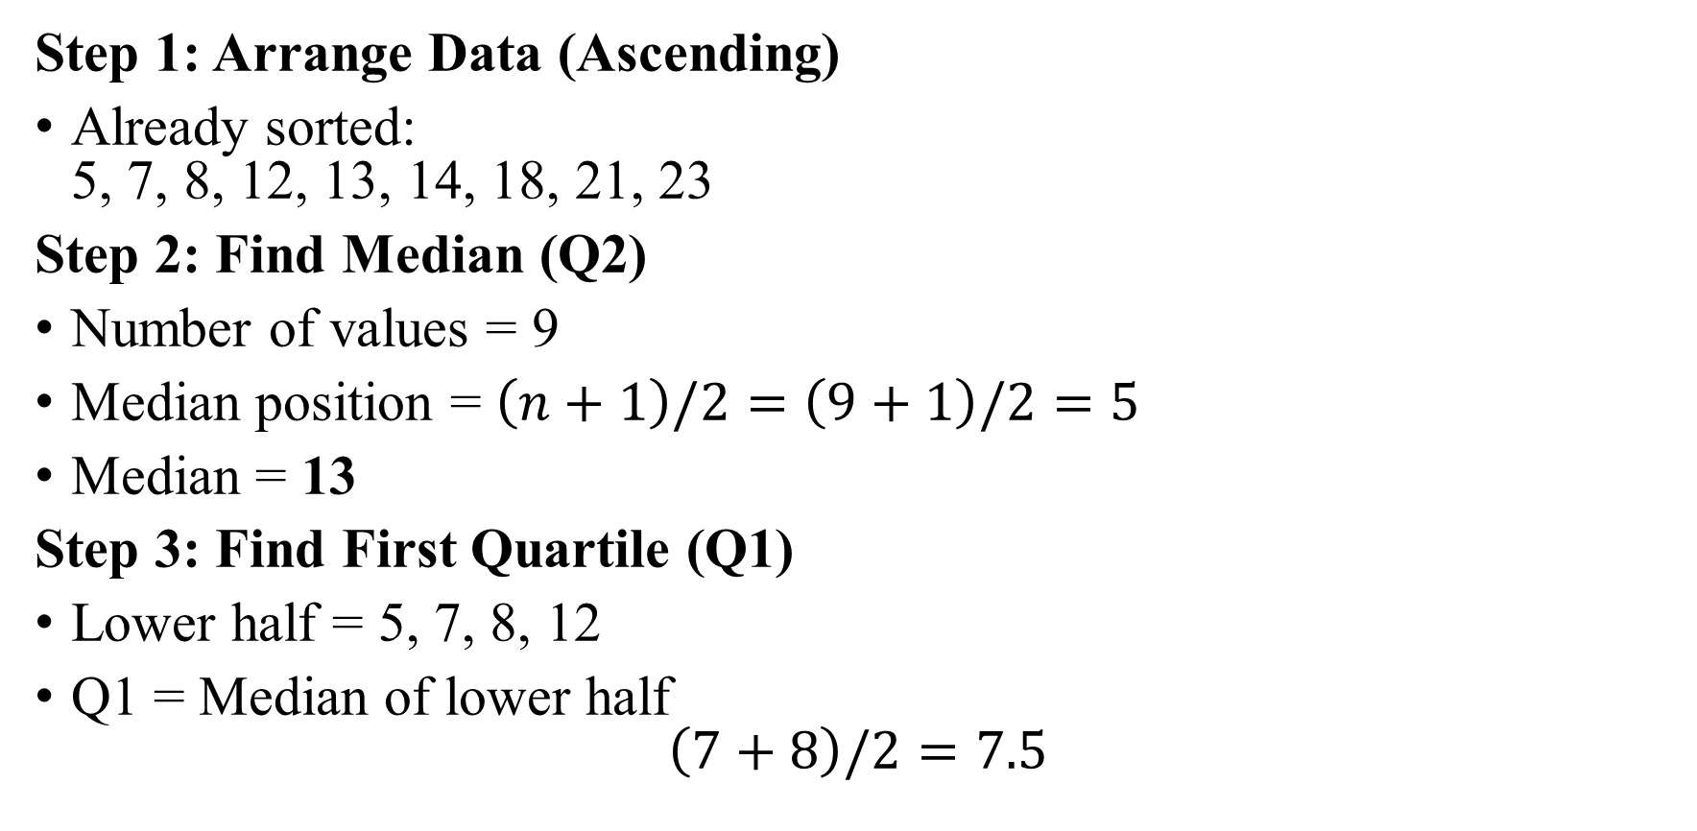
Step 1: Arrange Data (Ascending)
Already sorted: 5, 7, 8, 12, 13, 14, 18, 21, 23
Step 2: Find Median (Q2)
Number of values = 9
Median position = $\left(n+1\right)/2=\left(9+1\right)/2=5$
Median = 13
Step 3: Find First Quartile (Q1)
Lower half = 5, 7, 8, 12
Q1 = Median of lower half $\left(7+8\right)/2=7.5$

Slide 16
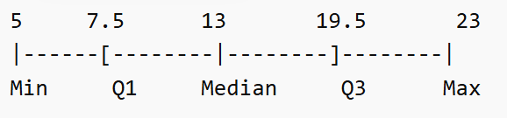
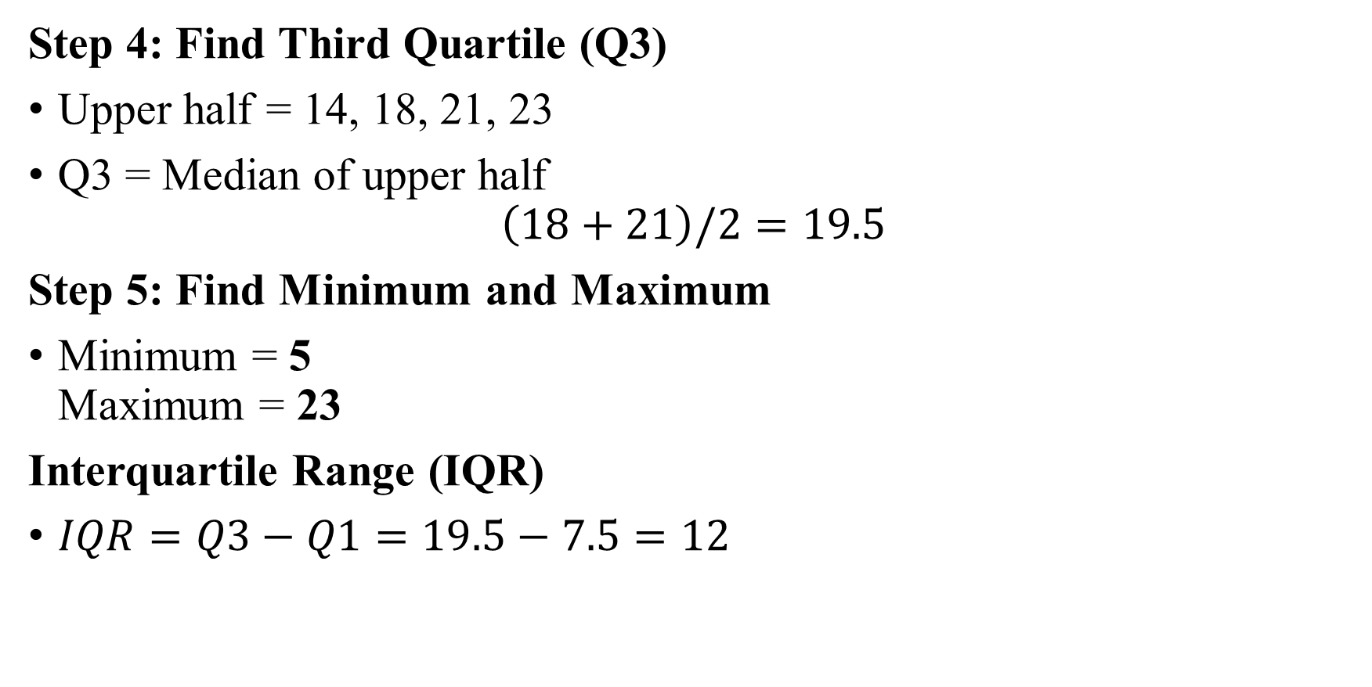
Step 4: Find Third Quartile (Q3)
Upper half = 14, 18, 21, 23
Q3 = Median of upper half $\left(18+21\right)/2=19.5$
Step 5: Find Minimum and Maximum
Minimum = 5 Maximum = 23
Interquartile Range (IQR)
$IQR=Q3−Q1=19.5−7.5=12$

Slide 17
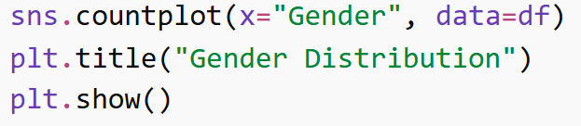
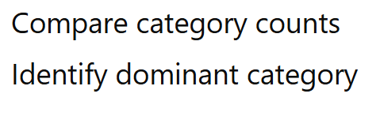
Count Plot (Categorical Variable):
Count plot shows frequency of categories.

Slide 18
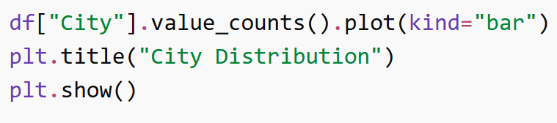
Bar Chart:
Bar charts visualize categorical data.

Slide 19
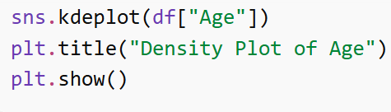
Density Plot:
Density plot shows probability distribution of numerical data.

